Slide 1


Project Presentation
242 - Data Modelling
Yelp Dataset

Slide 2
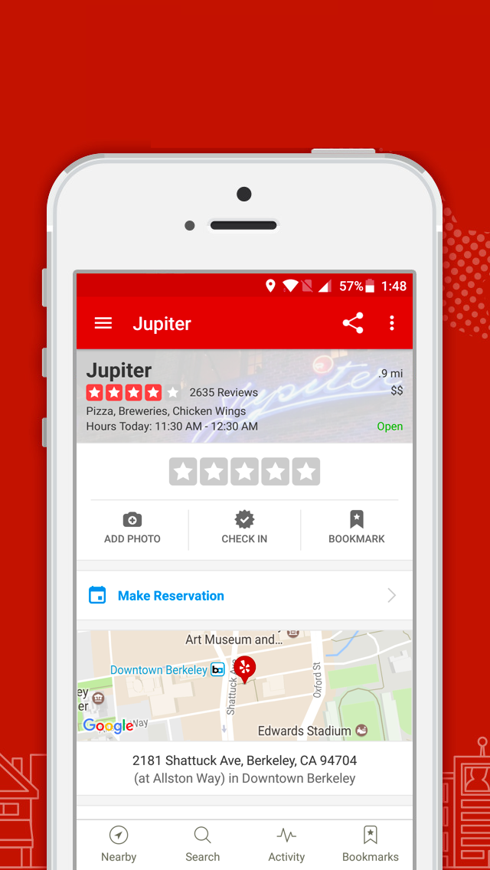
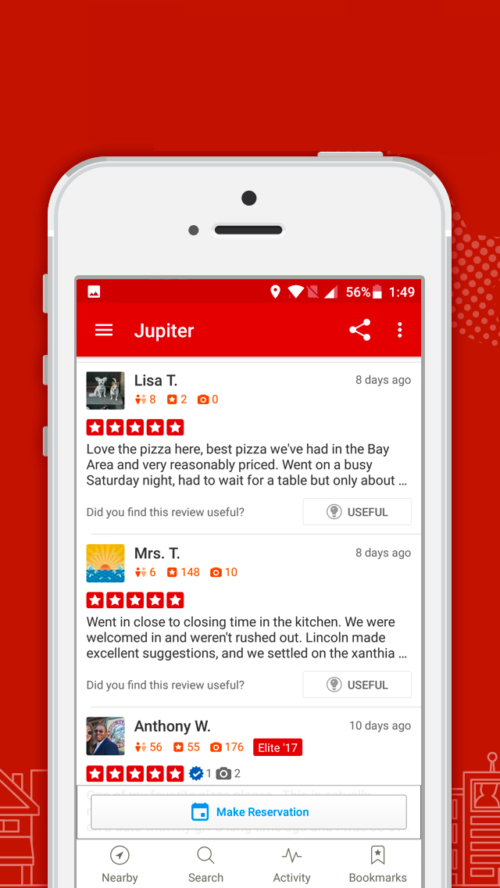
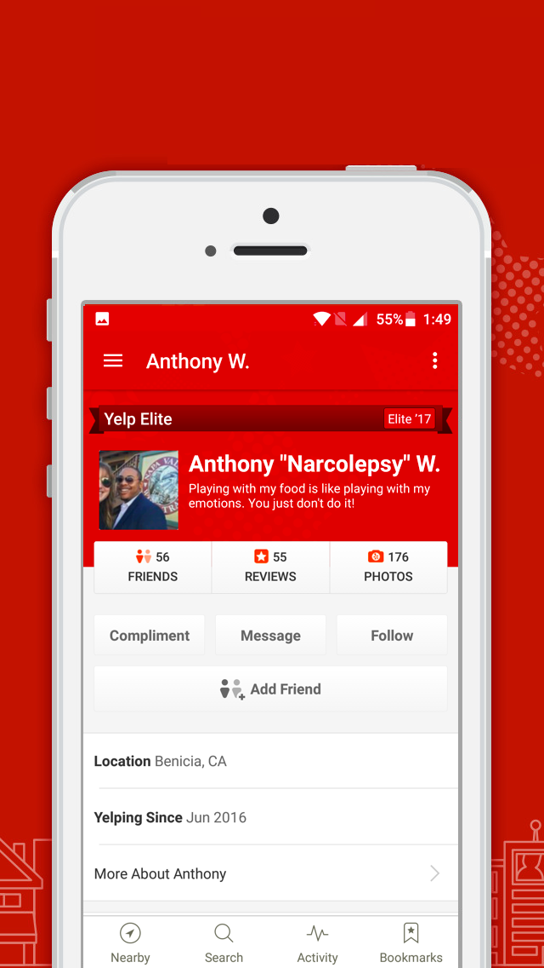
Business Dataset
Review Dataset
User Dataset

Slide 3
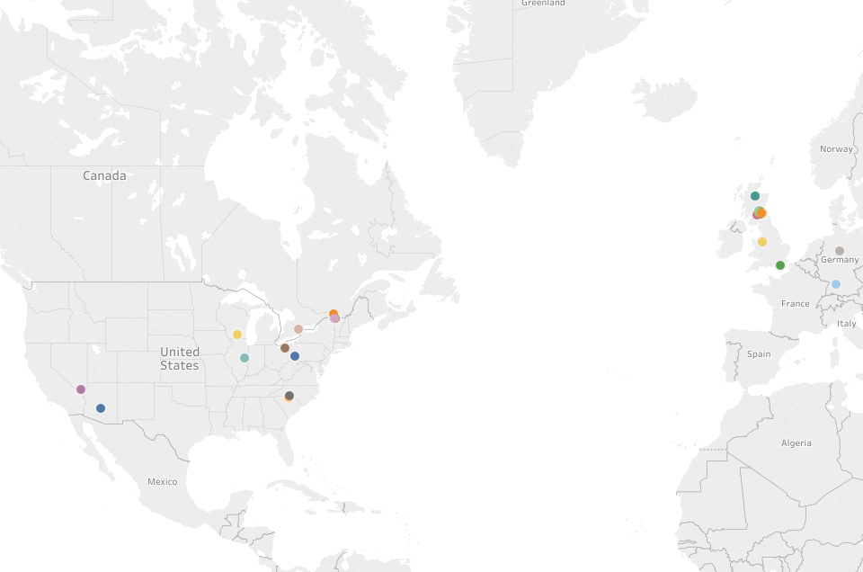
DATA STATISTICS
4
11
4.1M
1M
144K
Countries
Cities
Reviews
Users
Businesses

Slide 4
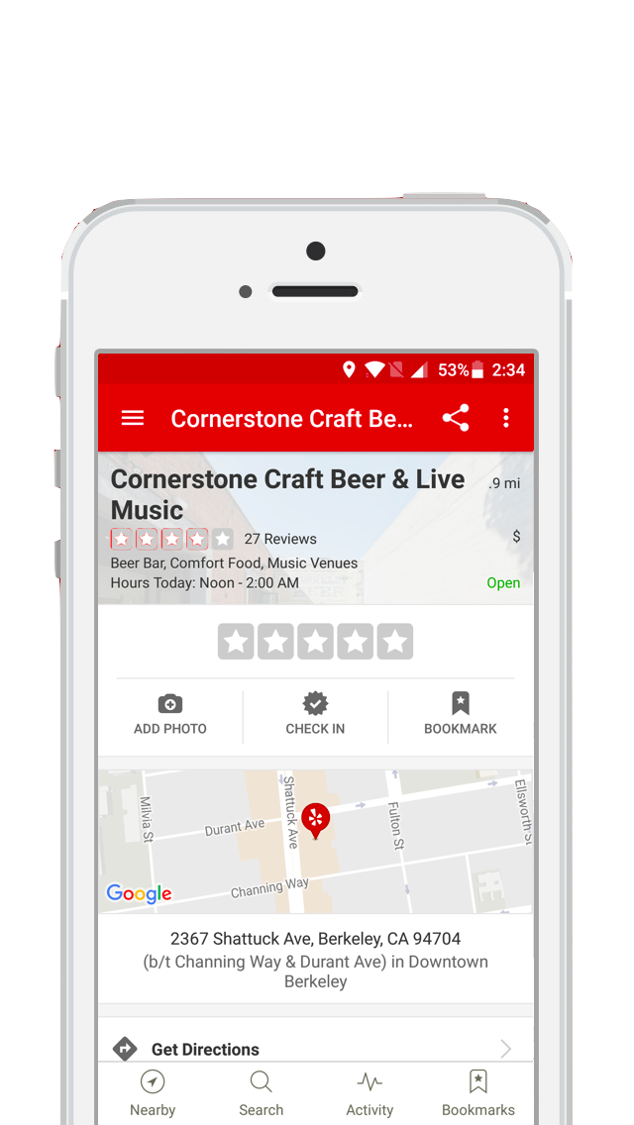
PROJECT OBJECTIVE - BUSINESS SOLUTION
NEW BUSINESS
“ DETERMINE THE RATING OF A BUSINESS ”

Slide 5
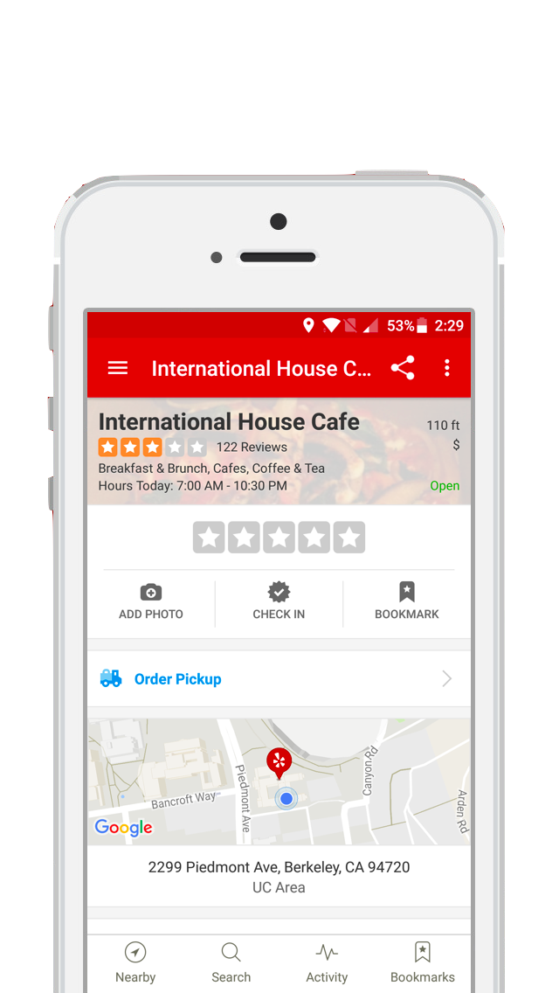
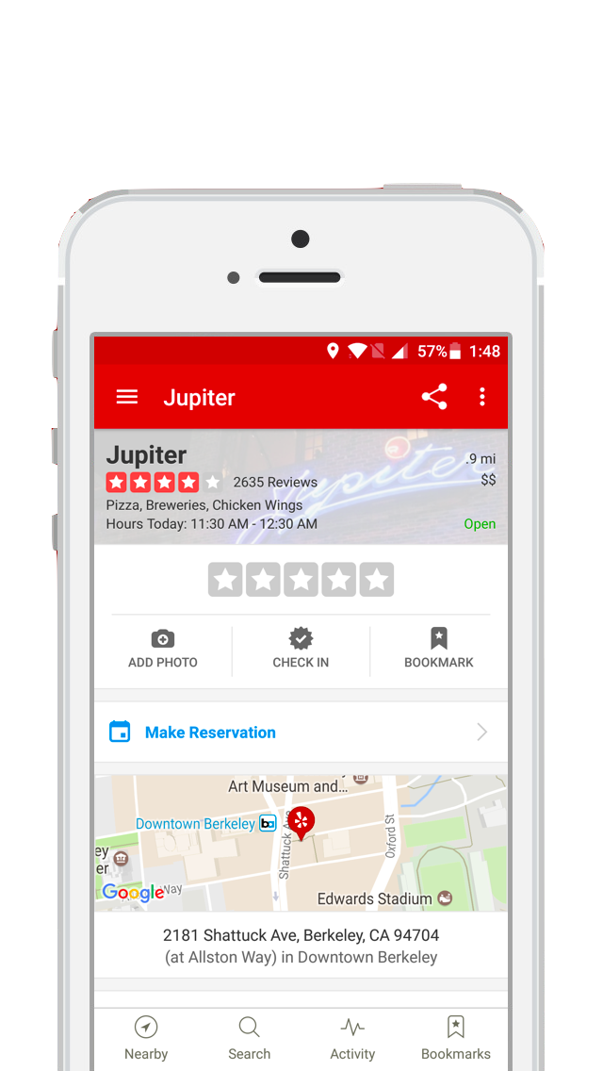
PROJECT OBJECTIVE - BUSINESS SOLUTION
EXISTING BUSINESS
“ IMPROVE THE RATING OF A BUSINESS ”

Slide 6
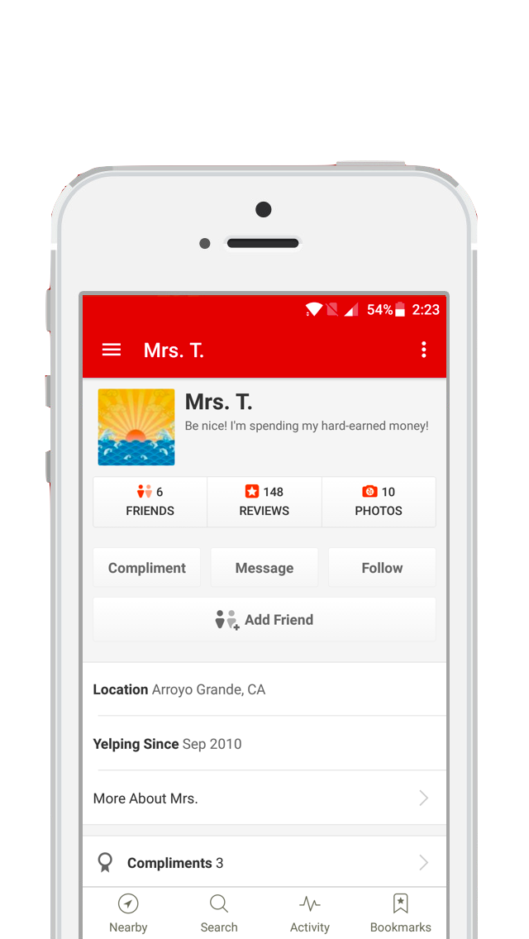
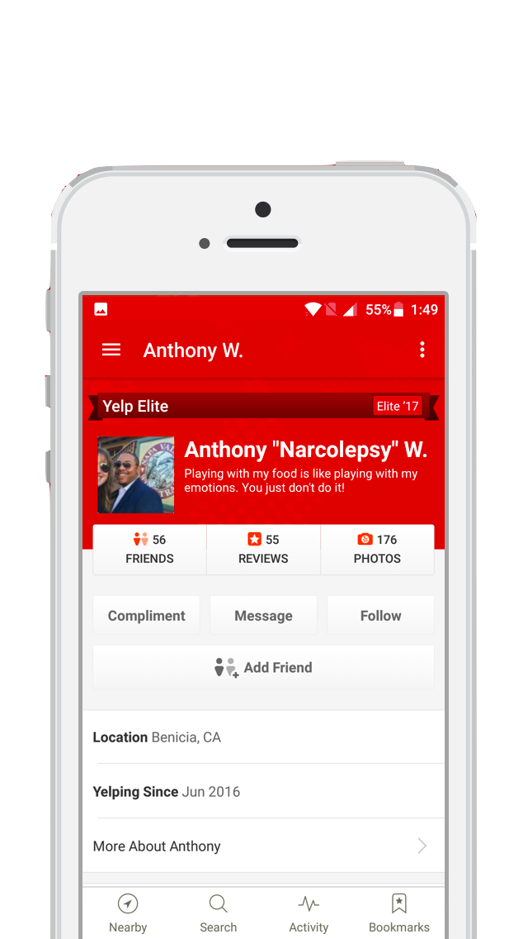
PROJECT OBJECTIVE - USER SOLUTION
“ DETERMINE WHEN A CUSTOMER BECOMES AN ‘ELITE’ CUSTOMER ”

Slide 7
NEW BUSINESS : “ DETERMINE THE RATING OF A BUSINESS ”
Why is this relevant? - People want to have a good business model
Data:
Business Attributes - 80+ business attributes separated out Examples - Wifi, Pets allowed, Parking, etc.
Business Categories - 1000+ unique categories Examples - Restaurant, Shopping, Nightlife, etc.
Business Hours - Derived opening hours, closing hours, open hours etc.
Notes:
Saketa please fill the examples
How did we narrow down these attributes and categories

Slide 8
Data Processing: Availability of Data
Business Attributes
Business Categories
Feature | Availability
business_id | 100
is_open | 100
latitude | 100
longitude | 100
name | 100
review_count | 100
stars | 100
state | 100
type | 100
garage | 64.23801988
validated | 63.63554334
BusinessAcceptsCreditCards | 61.79687934
GoodForKids | 42.81262147
RestaurantsTakeOut | 42.77097562
OutdoorSeating | 40.77336332
live | 40.39785663
neighborhood | 40.19448609
RestaurantsGoodForGroups | 40.14104059
RestaurantsDelivery | 38.15245155
WiFi | 34.81523127
NoiseLevel | 34.43556
casual | 34.407102
RestaurantsTableService | 34.08226442
romantic | 33.39024932
BikeParking | 32.65867066
Caters | 27.94297296
ByAppointmentOnly | 26.77341885
divey | 25.60733522
DogsAllowed | 14.96751624
GoodForDancing | 13.61124993
HappyHour | 13.55155755
CoatCheck | 13.31348215
Feature | Availability
address | 97.06119163
attributes | 88.26281304
Restaurants | 33.65331223
Shopping | 15.59359209
Food | 14.70722972
Beauty & Spas | 9.516769393
Home Services | 7.802348826
Nightlife | 7.304680993
Health & Medical | 7.271364318
Bars | 6.307263035
Automotive | 5.937309123
Local Services | 5.64509412
Event Planning & Services | 5.014159587
Active Life | 4.665722694
Fashion | 4.042423233
American (Traditional) | 3.687045366
Fast Food | 3.644011328
Pizza | 3.629435282
Sandwiches | 3.623188406
Coffee & Tea | 3.539202621
Hair Salons | 3.371925149
Hotels & Travel | 3.371231051
Arts & Entertainment | 3.276833805
Italian | 2.858293076
Auto Repair | 2.847187517
Home & Garden | 2.841634738

Slide 9
NEW BUSINESS
Method Implemented:
Classification (CART)
Prediction: The CART model always predicted a rating of 4
Reasons for failure:
The model could not find any relevant relations between the business attributes and the ratings
The model just predicted based on a simple probability
Rating | 1 | 1.5 | 2 | 2.5 | 3 | 3.5 | 4 | 4.5 | 5
Probability | 0.008 | 0.018 | 0.050 | 0.093 | 0.168 | 0.220 | 0.237 | 0.136 | 0.070

Slide 10
NEW BUSINESS
Cannot find a causal relationship
Real world scenario:
What matters is CUSTOMER EXPERIENCE !!

Slide 11
EXISTING BUSINESS : “ IMPROVE THE RATING OF A BUSINESS ”
Why is this relevant?
Businesses want to improve their ratings, and in turn understand their customers
Yelp can consult businesses and make money!
Data:
Not much relation with business attributes
Reviews:
‘Bag of words’ to come up with top influencers
Assigning sentiment to reviews (1 if rating > 3.5 ; 0 if rating < 3.5)

Slide 12
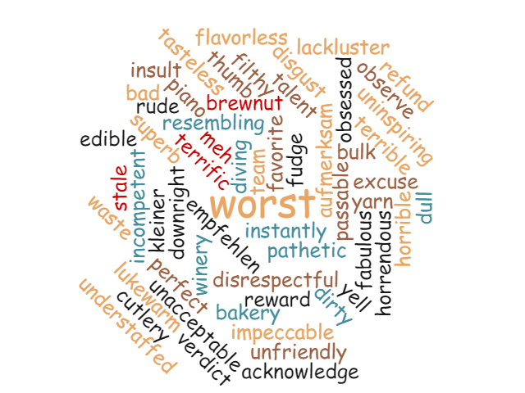
Data Processing: Word Cloud
SOME COMMON OPERATIONS:
Upper case to lower case
Removed punctuations and any other symbols
Removed stop words
Stemming, lemmatization

Slide 13
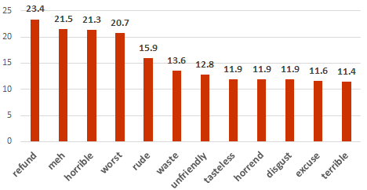
Data Processing: Most common words
Reviews with rating < 3.5
Most common words: Refund, ‘Meh’, Horrible, Worst, Rude, Unfriendly
Notes:
So here, we can see that the term "horrible" appears 21.3 more times as often in negative reviews as it does in positive reviews

Slide 14
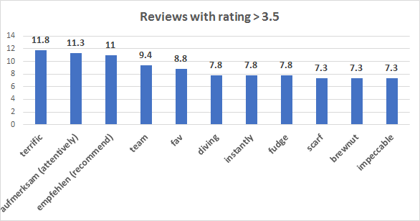
Data Processing: Most common words
Reviews with rating > 3.5
Most common words: Terrific, ‘Fav’, Recommend, Impeccable, Attentive
Notes:
So here, we can see that the term "horrible" appears 21.3 more times as often in negative reviews as it does in positive reviews

Slide 15
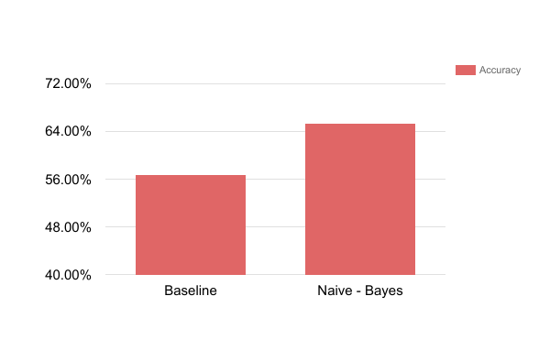
EXISTING BUSINESS
Method Implemented:
Classification
65.30%
56.70%
Notes:
Saketa please fill the examples
How did we narrow down these attributes and categories

Slide 16
EXISTING BUSINESS
Reviews form a significant feature for predicting ratings of a business
Real world scenario:
What matters is CUSTOMER EXPERIENCE !!

Slide 17
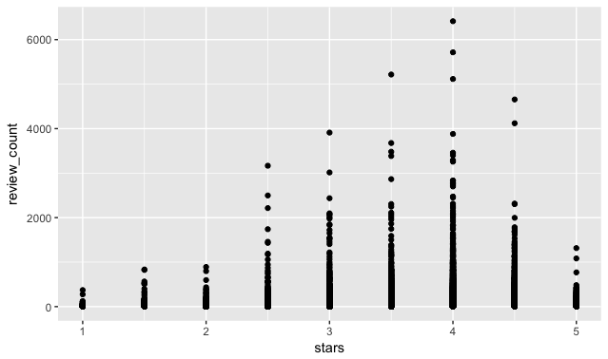
INSIGHTS
As the number of reviews go up, the ratings tend to stabilize.
Review Count
Star Rating

Slide 18
USER SOLUTION : “ DETERMINE ‘ELITE’ CUSTOMERS ”
Why is this relevant? - As Yelp puts it “ It’s neat to be elite! ”
But generally speaking
Users want the benefits of being elite
Businesses want to target the people who are elite or are about to be elite
Yelp wants to maintain the quality of elite users
Data:
User Attributes - Friends, Fans, Reviews given, Photographs, etc.
Compliments Received - Hot, Cool, Funny, etc.
Votes given - Funny, Useful, etc.
Notes:
Invite to review new businesses
Exclusive event invites

Slide 19
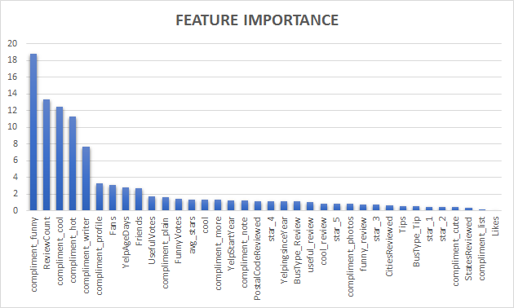
Data Processing: Importance Analysis
Features
Most important features: Compliments, Review counts, Fans, Friends
Notes:
So here, we can see that the term "horrible" appears 21.3 more times as often in negative reviews as it does in positive reviews

Slide 20
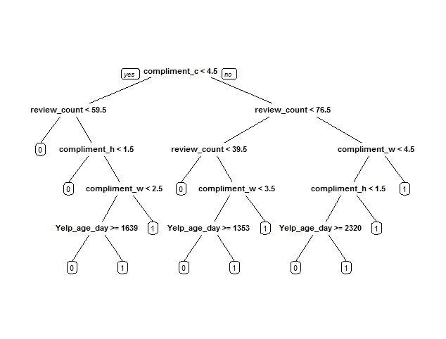
USER SOLUTION
Method Implemented:
Classification

Slide 21
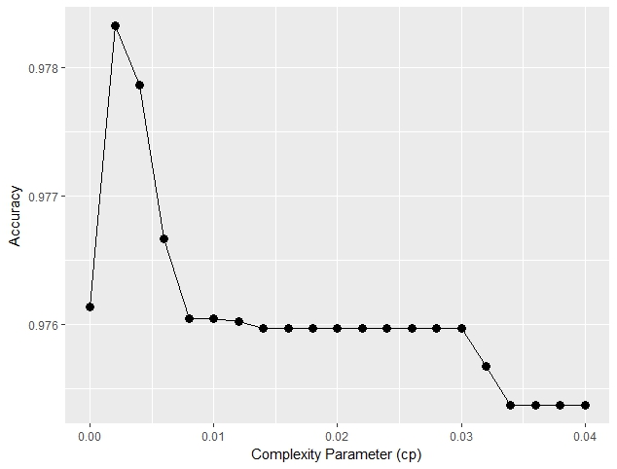
USER SOLUTION
Method Implemented:
Classification
0.02
Accuracy
Complexity Parameter (cp)
Notes:
Saketa please fill the examples
How did we narrow down these attributes and categories

Slide 22
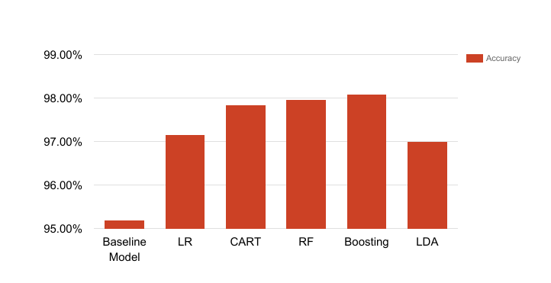
USER SOLUTION
Method Implemented:
Classification
97.97%
98.09%
97.85%
97.16%
97%
95.20%
Notes:
Saketa please fill the examples
How did we narrow down these attributes and categories

Slide 23
USER SOLUTION
Model Statistics
Models | Accuracy | TPR | TNR
Baseline | 95.20% | 0% | 95.2%
Logistic Regression | 97.16% | 58.67% | 99.09%
CART | 97.85% | 72.38% | 99.13%
Random Forest | 97.97% | 71.85% | 99.29%
Boosting | 98.09% | 76.93% | 99.16%
LDA | 97% | 51.61% | 99.3%
Notes:
https://docs.google.com/spreadsheets/d/19R70qOW_ApDLfWCH-5rZBgISP6MYB8pZTCKHZzGRbtg/edit#gid=1394513336

Slide 24
USER SOLUTION
Boosting gives a good prediction
So contact us if you want to become an ‘ELITE’ user.

Slide 25
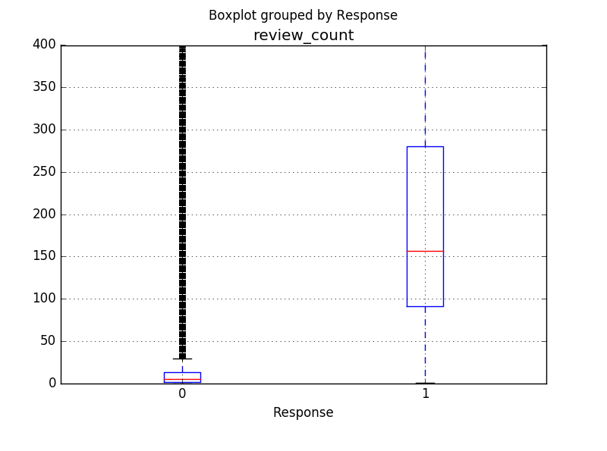
INSIGHTS
Quality over quantity.
Even though some users have reviews in 1000’s but the median for the number of reviews needed to become an ‘Elite’ customer is 157.
Review Count
Response
Notes:
Elite-Mean: 234.293 , Non Elite-Mean: 13.67

Slide 26
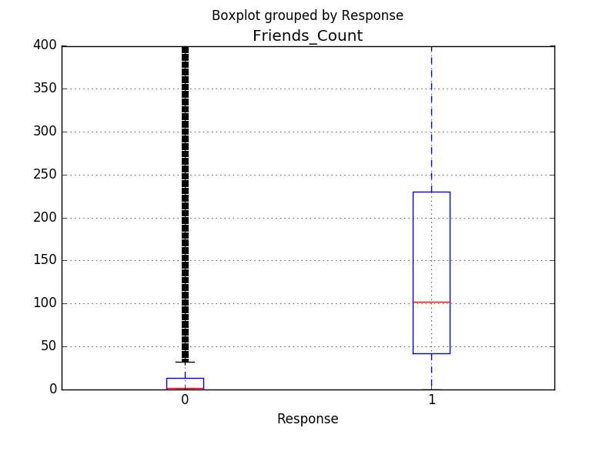
INSIGHTS
Friends Matter!!
The Friends Network is highly related to the user being an ‘Elite’
Friends on Yelp
Response
Notes:
Elite - Mean: 215/Median - 105

Slide 27
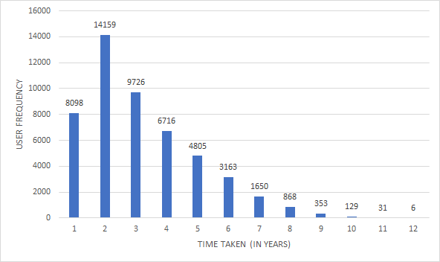
INSIGHTS
Age ≠ Wisdom.
The Yelp Age is not directly proportional to the user being an ‘Elite’
User Frequency
Time Taken (in years)

Slide 28
CONCLUSION
We want Yelp to have more insight into businesses and users.
Business attributes do not have causal relationship with the ratings of a business
User reviews matter the most for a business rating
‘Elite’ user reviews attract more customers

Slide 29
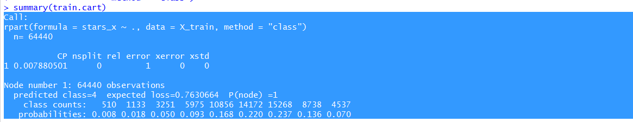
APPENDIX
CART model for New Businesses

Slide 30
DECISION TREE

Slide 31
CROSS VALIDATION: BEST CP VALUE

Slide 32
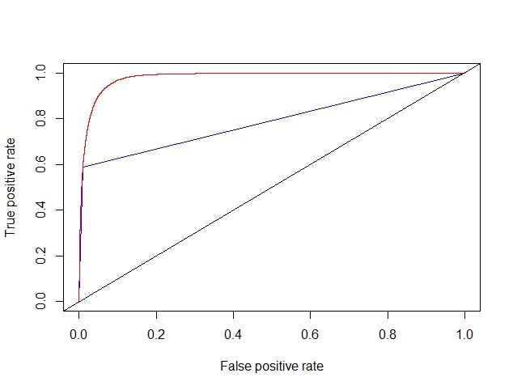
LINEAR DISCRIMINANT ANALYSIS vs LOGISTIC REGRESSION

